Slide 1


Team 4 Project Proposal Overview:
MAE: Jake Honma & Harsh Savla | ECE: Andrew Dunker | Math/CS: Jingli Zhou
Goals:
Document the process to configure TensorFlow and DonkeyCar using a Raspberry Pi with an AI accelerator Hat.
Measure the performance of the Raspberry Pi 5 (with and without the AI Hat) relative to the Jetson Nano & Jetson Xavier NX.
Determine the feasibility of replacing the Jetson Nano with the Raspberry Pi 5 with AI Hat+ in ECE/MAE 148.
Requirements: Jetson Nano, Jetson NX, Raspberry with Hailo AI Hat
ECE MAE 148 | Winter 2025
Notes:
Jingli

Slide 2
Deliverables
Must Have :
Benchmarked performance for:
Jetson Nano w Tensorflow/TensorRT
Jetson NX w Tensorflow/TensorRT
RPI w Tensorflow/HailoRT
Documentation for the Process.
Nice to Have :
Benchmarked performance at different resolutions
Fully integrate the Hailo Model with DonkeyCar
ECE MAE 148 | Winter 2025
Notes:
Jingli

Slide 3
Hardware Overview:
 | Jetson Nano | Jetson NX | Raspberry Pi 5 w Hailo Hat
CPU | Quad-core ARM Cortex-A57 | 6-core ARM v8.2 64-bit CPU (Carmel) | Quad-core ARM Cortex-A76
GPU | 128-core Maxwell | 384-core Volta GPU with 48 Tensor Cores | 12-core VideoCore VII
NPU | N/A | N/A | Hailo-8 AI Accelerator
Memory | 4GB LPDDR4 | 8GB LPDDR4x | 4/8GB LPDDR4X
Performance | 0.472 TFLOPS (FP16) ~1.88 TOPS (TOPS) | 21 TOPS (INT8) | 26 TOPS (INT8)
Cost | $225 | $650 - 800 | $70 (+$10 for 8GB RAM) (+$70 for AI Hat)
ECE MAE 148 | Winter 2025
Notes:
Jingli

Slide 4
Software Overview:
 | Jetson Nano | Jetson Nano (w/ Docker) | Jetson NX | Raspberry Pi 5
Donkeycar | 4.5.1 | 5.1.dev0 | 5.1.dev0 | 5.2.dev2
Python | 3.6.9 | 3.8.10 | 3.8.10 | 3.11.2
Tensorflow | 2.5.0 | 2.12.0 | 2.12.0 | 2.15.1
Pytorch | 1.8.0 | 2.1.0a0+41361538.nv23.06 | 2.1.0a0+41361538.nv23.06 | N/A
TensorRT | 7.1.3.0-1+cuda10.2 | 8.5.2.2-1+cuda11.4 | 8.5.2.2-1+cuda11.4 | N/A
ECE MAE 148 | Winter 2025
Notes:
Jingli

Slide 5
CPU & GPU & NPU
CPU(Central Processing Unit): The hardware that is essentially the brain of the computer, and used for general computing. The Jetson uses the ARM architecture.
GPU(Graphic Processing Unit): In a process called parallel computing, GPUs break down large tasks into smaller ones that can be ran in parallel. Softwares like Tensorflow, utilize libraries like CUDA to offload computation and inference to the GPU, accelerating the computational time.
NPU(Neural Processing Unit): NPUs are specialized processors for neural networks. They are optimized for matrix operations, parallel processing, and low latency. This means computationally expensive task such as deep learning can be offloaded here.
CPU: Decision Making
GPU: Offloads Parallel Task.
Cuda: allows parallel processing
Tensor RT: specialized for NVIDIA GPUs
NPU:Offload Deep Learning Task.
ECE MAE 148 | Winter 2025
Notes:
Jingli

Slide 6
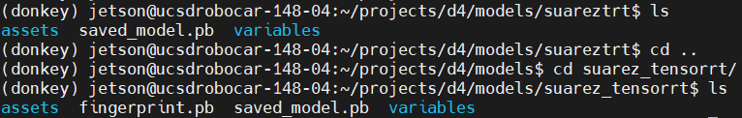
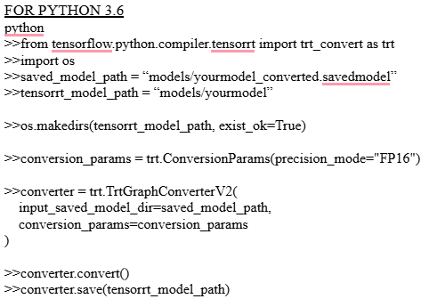
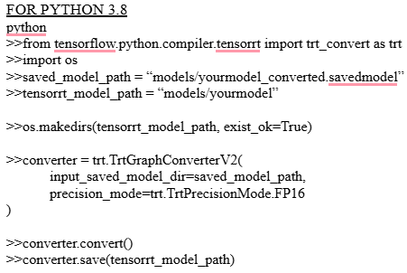
What We Did: Jetson/Tensor RT
.h5 → .savedmodel → tensorrt directory (worked w/ DSE 190 Team)
Different processes for Python 3.6 and 3.8 (creates directories w/ different contents)
Python 3.6:
Python 3.8:
Problems: Outdated documentation (.uff) & GPU access in a docker
ECE MAE 148 | Winter 2025
Notes:
Jake

Slide 7
What we did: RPI
To Benchmark Running DonkeyCar: DonkeyCar has documentation to set up and run donkey on the raspberry pi. After installing DonkeyCar the process is the same as it is with the Jetson (without TensorRT).
To Benchmark with Hailo RT:
Research how the Hailo NPU can be accessed through the RPI →
Research what models the Hailo NPU can run. →
Research, Implement and Debug Model conversion from .h5 to .hef
Research and Implement Benchmark .hef using the Hailo toolkit.
Integrate .hef into DonkeyCar
ECE MAE 148 | Winter 2025
Notes:
Harsh

Slide 8
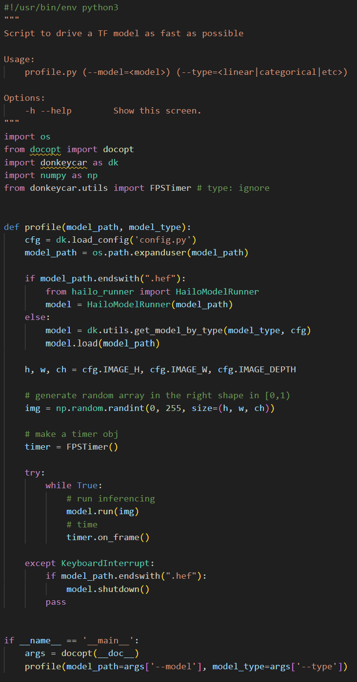
Profile.py
DonkeyCar’s benchmarking tool
Loads a model
Creates random image data
Calculates FPS from the amount of time between run command and a response form model
Notes:
Andrew

Slide 9
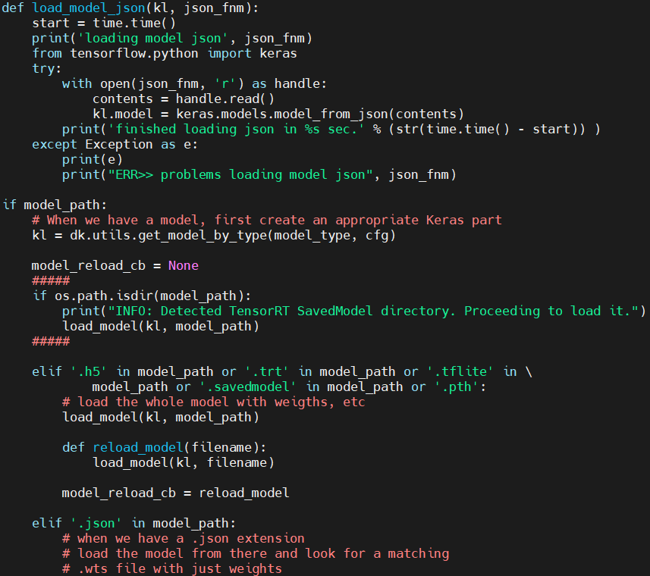
manage.py
The hub of using DonkeyCar
For autopilot
Checks the model’s file extension to determine model type
Loads specified model type with model file
If your model is not static, it allows reloading for some model types
Model object is then handed off to
Notes:
Andrew

Slide 10
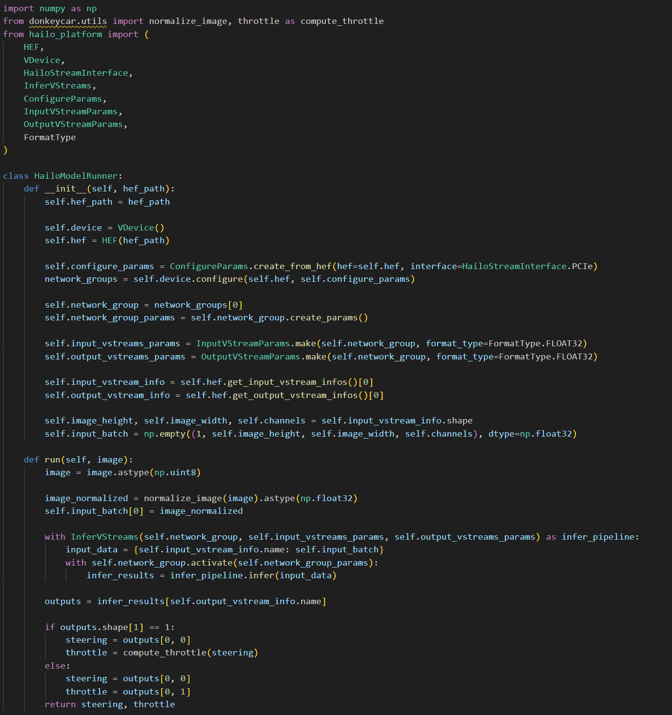
hailo_runner.py
The HailoModelRunner class is designed to be indistinguishable from other models used by DonkeyCar
RGB Image input -> run method -> Steering, Throttle tuple output
In its current form, it is faster than most of its competition, but could be much faster

Slide 11
Final Metrics: Same Model at 120x160 res
 | Jetson Nano | Jetson Nano (w/ Donkey 5.1.dev0) | Jetson NX | Raspberry Pi 5
Linear (.h5) | 46-47 fps | 26 fps | 41-42 fps | 61-66 fps
TFLite (.tflite) | 62 fps | 80 fps | 125-126fps | 313fps
TensorRT (directory) | 82fps | N/A | 250-260fps | N/A
Hailo (.hef) | N/A | N/A | N/A | 217**fps
**With its own benchmarking tool the Hailo model can perform at over 13000 fps, and given is higher performance spec and better optimized model, it is likely that our method of integrating Hailo into DonkeyCar is not optimized.
ECE MAE 148 | Team 4 | Winter 2025
Notes:
Jake - Jetson
Harsh/Andrew - RPI

Slide 12
Training Higher Resolution Models
Attempted to train:
120x160 pixel
360p
720p
360p and above would not train on Datahub
Attempted to train locally on a more powerful GPU instead
720p maxed out VRAM usage and has very large RAM usage
Required optimizing DonkeyCar’s training process
Optimized Keras VRAM usage in DonkeyCar
Attempted to implement Mixed Precision Training
Dropped batch size to 8
Was only able to successfully train for 4 epochs
ECE MAE 148 | Team 4 | Winter 2025

Slide 13
Final Recommendation:
Use Case Based Recommendations:
If you own a Jetson (Nano/NX): Jetson You can boost the performance of your Jetson using Tensor RT and given the limited support for the Hailo AI hat, the upgrade is not worthwhile.
If you own a RPI 5: RPI 5 (w future Hailo Hat upgrade option) Without acceleration the RPI 5 outperforms both Jetson models, and given its compatibility with newer software, larger support infrastructure, lower cost and the possibility of the integration of the AI Hat with DonkeyCar makes it a future proof purchase.
If you a looking to purchase a new processor: RPI 5 (w future Hailo Hat upgrade option) Considering the RPI has better compatibility with new software, a larger support infrastructure, lower cost, more developers, and likely integration with the AI hat, it is a better purchase.
For this class: To boost performance you can use TensorRT acceleration, especially since Hailo is not fully integrated. If you are looking to upgrade the current hardware, the RPI 5 is a better option.
ECE MAE 148 | Team 4 | Winter 2025

Slide 14
Future Prospects to build on this project
Optimize the integration of Hailo in DonkeyCar
Though we were able to get a .hef file to run in DonkeyCar, based on the results and what we expected, the integration could be performed more efficiently.
Test Models at Different Resolutions
Test and optimize models based on OAKD lite resolution and hardware (Jetson vs. Raspberry Pi 5) to find the highest performing resolutions for deep learning.
Continue to Optimize DonkeyCar Training
Finish optimizing memory management to allow training of larger resolution models
ECE MAE 148 | Team 4 | Winter 2025

Slide 15
What did not work as expected
Out of date documentation for TensorRT conversion (.uff)
Creating .hef model
Training new models due to GPU Cluster
Had to train locally which minimized how much time we had to test the performance of various models
Full integration of Hailo Executable Files (.hef)
Running manage.py due to Vesc problems at low speeds

Slide 16
Linked Documentation
Jetson Benchmarking w/wo TensorRT Conversion
Raspberry Pi Setup & AI Hat Benchmarking
ECE MAE 148 | Team 4 | Winter 2025

